Slide 1
Chapter 1
Signals and Signal Processing

Slide 2
Signals and Signal Processing
Signals play an important role in our daily life
A signal is a function(函数) of independent variables(自变量) such as time, distance, position, temperature, and pressure
Some examples of typical signals are shown next

Slide 3
Examples of Typical Signals
Speech and music signals-Represent air pressure as a function of time at a point in space
Electrocardiography (ECG心电图) Signal-Represents the electrical activity of the heart
A typical ECG signal is shown in Figure 1.12(a)

Slide 4
Examples of Typical Signals
The ECG trace is periodic(周期的) waveform(波形)
One period of the waveform shown in Figure 1.12(b) represents one cycle(循环) of the blood transfer(传输) process from the heart to the arteries(动脉)

Slide 5
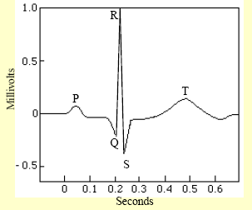

Slide 6
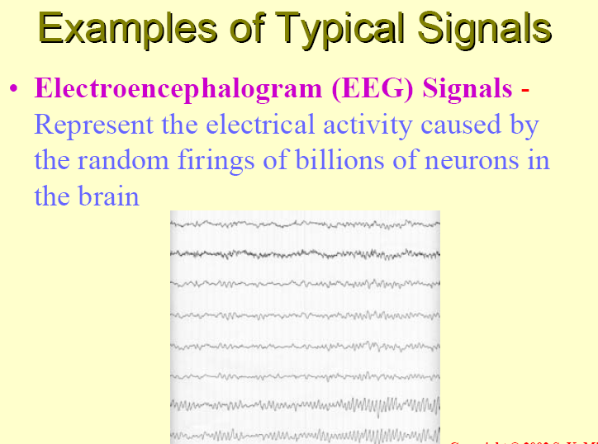

Slide 7
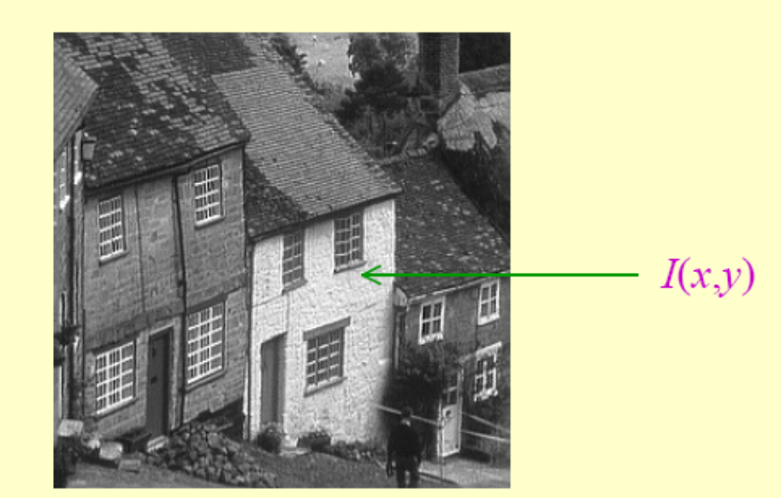
Examples of Typical Signals
Black-and-white picture – Represents light intensity as a function of two spatial (空间的)coordinates(坐标)

Slide 8

Examples of Typical Signals

Slide 9



Examples of Typical Signals
Video(视频) signals – Consists of a sequence of images, called frames(帧), and is a function of 3 variables: 2 spatial coordinates and time

Slide 10
Signals and Signal Processing
Most signals we encounter(遇到) are generated naturally
However, a signal can also be generated synthetically(合成的) or by a computer

Slide 11
Signals and Signal Processing
A signal carries information(信息)
Objective(目标) of signal processing: Extract(提取) the useful information carried by the signal
Method of information extraction: Depends on the type of signal and the nature of the information being carried by the signal

Slide 12
Signals and Signal Processing
Signals can be represented in the domain of the original independent variables or in a transformed domain
Likewise, the information extraction process may be carried out in the original domain of the signal or in a transformed domain
This course is concerned with(关于) the discrete-time(离散时间) representation(表示法) of signals and their discrete-time processing

Slide 13
Characterization and
Classification of Signals
特征，描述
Types of signal: Depends on the nature of the independent variables and the value of the function defining the signal
For example, the independent variables can be continuous or discrete
Likewise, the signal can be a continuous or discrete function of the independent variables

Slide 14
Characterization and
Classification of Signals
Continuous signals vs. discrete signals
Real signals vs. complex signals
Scalar(标量) signals vs. vector(矢量) signals
One dimensional signals vs. multi-dimensional signals
Deterministic signal vs. random signal

Slide 15
Characterization and
Classification of Signals
A one-dimensional(1-D一维) signal is a function of a single independent variable
A multidimensional(M-D) signal is a function of more than one independent variables
The speech signal is an example of a 1-D signal where the independent variable is time

Slide 16
Characterization and
Classification of Signals
An image(图像) signal, such as a photograph(照片), is an example of a 2-D signal where the 2 independent variables are the 2 spatial variables
A color image signal is composed of three 2-D signals representing the three primary colors: red, green and blue (RGB)

Slide 17



Characterization and
Classification of Signals
The 3 color components of a color image are shown below

Slide 18

Characterization and
Classification of Signals
The full color image obtained by displaying the previous 3 color components is shown below

Slide 19
Characterization and
Classification of Signals
Each frame of a black-and-white digital video signal is a 2-D image signal that is a function of 2 discrete spatial variables, with each frame occurring(出现) at discrete instants(时刻) of time
Hence, black-and-white digital video signal can be considered as an example of a 3-D signal where the 3 independent variables are the 2 spatial variables and time

Slide 20
Characterization and
Classification of Signals
A color video signal is a 3-channel signal composed of three 3-D signals representing the three primary colors: red, green and blue (RGB)
For transmission purposes, the RGB television signal is transformed into another type of 3-channel signal composed of a luminance(亮度) component and 2 chrominance(色度) components

Slide 21
Characterization and
Classification of Signals
For a 1-D signal, the independent variable is usually labeled as time
If the independent variable is continuous, the signal is called a continuous-time signal
If the independent variable is discrete, the signal is called a discrete-time signal

Slide 22
Characterization and
Classification of Signals
A continuous-time signal is defined at every instant of time
A discrete-time signal is defined at discrete instants of time, and hence, it is a sequence(序列) of numbers
A continuous-time signal with a continuous amplitude(幅度) is usually called an analog(模拟) signal
A speech(语音) signal is an example of an analog signal

Slide 23
Characterization and
Classification of Signals
A discrete-time signal with discrete-valued amplitudes represented by a finite(有限的) number of digits is referred to as the digital signal
An example of a digital signal is the digitized(数字化) music signal stored in a CD-ROM disk
A discrete-time signal with continuous-valued amplitudes is called a sampled-data(抽样数据) signal

Slide 24
Characterization and
Classification of Signals
A digital signal is thus a quantized(量化的) sampled-data signal
A continuous-time signal with discrete-value amplitudes is usually called a quantized boxcar signal(量化矩形信号)
Figure1.1 illustrates the 4 types of signals

Slide 25
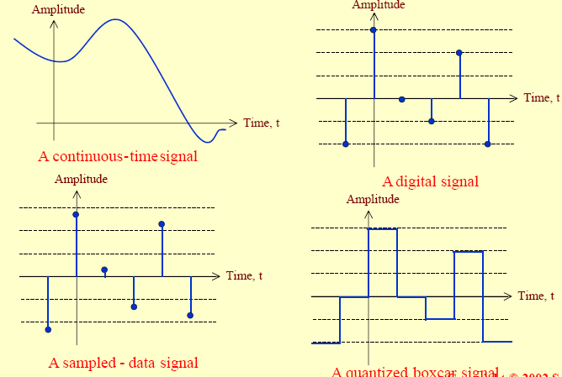

Slide 26


Characterization and
Classification of Signals
The functional dependent(函数关系) of a signal in its mathematical representation is often explicitly(清楚的) shown
For a continuous-time 1-D signal, the continuous independent variable is usually denoted by
For example, represents a continuous- time 1-D signal

Slide 27

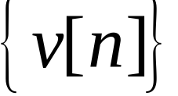

Characterization and
Classification of Signals
For a discrete-time 1-D signal, the discrete independent variable is usually denoted by
For example, represents a discrete-time 1-D signal
Each member, , of a discrete-time signal is called a sample(样本)

Slide 28
Characterization and
Classification of Signals
In many applications, a discrete-time signal is generated by sampling(采样) a parent(原始的) continuous-time signal at uniform(统一的) intervals(间隔) of time
If the discrete instants of time at which a discrete-time signal is defined are uniformly spaced, the independent discrete variable n can be normalized(归一化) to assume integer(整数) values

Slide 29
Characterization and
Classification of Signals
In the case of a continuous-time 2-D signal, the 2 independent variables are the spatial coordinates, usually denoted by x and y
For example, the intensity(强度) of a black-and-white image at location (x,y) can be expressed as u(x,y)

Slide 30
Characterization and
Classification of Signals
On the other hand, a digitized image is a 2-D discrete-time signal, and its 2 independent variables are discretized spatial variables, often denoted by m and n
Thus, a digitized image can be represented as v[m,n]
A black-and-white video signal is a 3-D signal and can be represented as u(x,y,t)

Slide 31
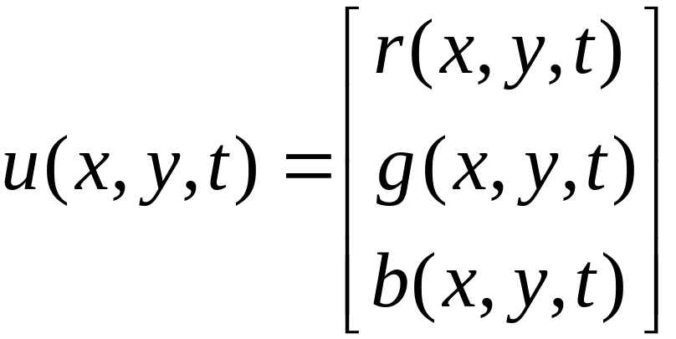
Characterization and
Classification of Signals
A color video signal is a vector signal composed of 3 signals representing the 3 primary colors: red, green, and blue

Slide 32
Characterization and
Classification of Signals
A signal that can be uniquely(唯一的) determined by a well-defined(完全定义的) process, such as a mathematical expression or rule, or table look-up(查找表), is called a deterministic(确定的) signal
A signal that is generated in a random(随机) fashion and cannot be predicted(预测) ahead of time is called a random signal

Slide 33
Typical Signal Processing Operations
Most signal processing operations(运算) in the case of analog signals are carried out in the time-domain(时域)
In the case of discrete-time signals, both time-domain or frequency-domain(频域) operations are usually employed

Slide 34
Simple Time-Domain Operations
Three most basic time-domain signal operations are scaling(标乘), delay, and addition
Scaling is simply the multiplication(相乘) of a signal either by a positive(正的) or negative(负的) constant(常数)
In the case of analog signals, the operation is usually called amplification(放大) if the magnitude of the multiplying constant, called gain(增益), is greater than 1

Slide 35



Simple Time-Domain Operations
If the magnitude of the multiplying constant is less than 1, the operation is called attenuation(衰减)
If is an analog signal that is scaled by a constant , then the scaling operation generates a signal
Two other elementary operations are integration(积分) and differentiation(微分)

Slide 36
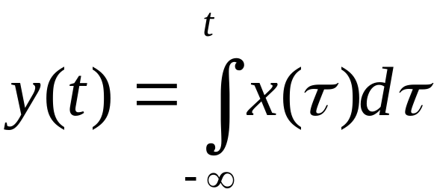
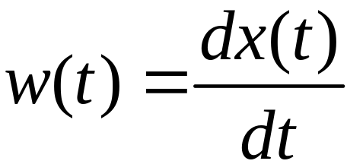
Simple Time-Domain Operations
The integration of an analog signal x(t) generates a signal
The differentiation of an analog signal x(t) generates a signal

Slide 37
Simple Time-Domain Operations
The delay(延时) operation generates a signal that is a delayed replica(复制品) of the original signal
For an analog signal x(t),
y(t)=x(t-t₀)
is the signal obtained by delaying x(t) by the amount of time t₀ which is assumed(假定) to be a positive number
If t₀ is negative, then it is an advance(超前) operation

Slide 38
Simple Time-Domain Operations
Many applications require operations involving two or more signals to generate a new signal
For example,
y(t)=x₁(t)+ x₂(t)+ x₃(t)
is the signal generated by the addition of the three analog signals, x₁(t), x₂(t), and x₃(t)

Slide 39
Simple Time-Domain Operations
The product(乘积) of 2 signals, x₁(t) and x₂(t), generates a signal
y(t)=x₁(t)x₂(t)
The elementary operations discussed so far are also carried out on discrete-time signals
More complex operations are implemented by combining(组合) two or more elementary operations

Slide 40
Filtering
Filtering(滤波) is one of the most widely used complex signal processing operations
The system implementing(实现) this operation is called a filter(滤波器)
A filter passes certain frequency components without any distortion and blocks(阻止) other frequency components

Slide 41
Filtering
The range of frequencies that is allowed to pass through the filter is called the passband(通带), and the range of frequencies that is blocked by the filter is called the stopband(阻带)
In most cases, the filtering operation for analog signals is linear(线性的)

Slide 42

Filtering
A lowpass(低通) filter passes all low-frequency components below a certain specified frequency , called the cutoff frequency(截止频率), and blocks all high-frequency components above
A highpass filter passes all high-frequency components a certain cutoff frequency
and blocks all low-frequency components
below

Slide 43
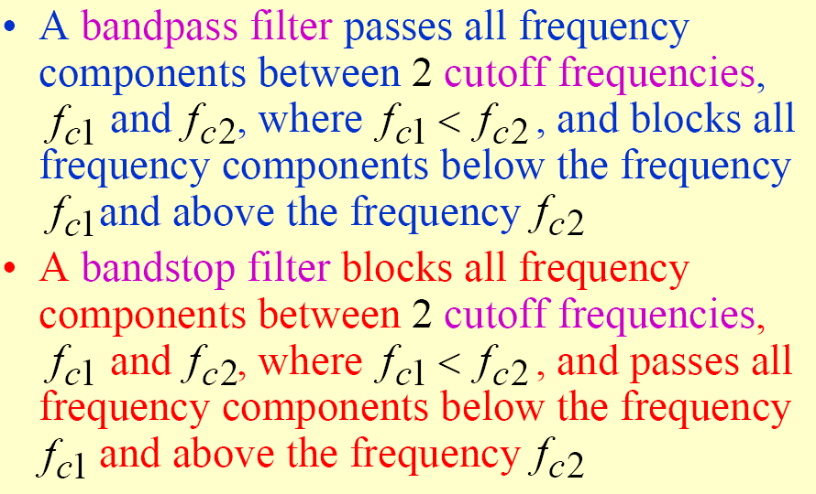
Filtering

Slide 44
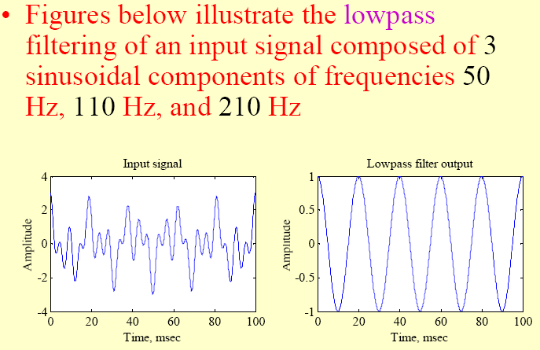

Slide 45
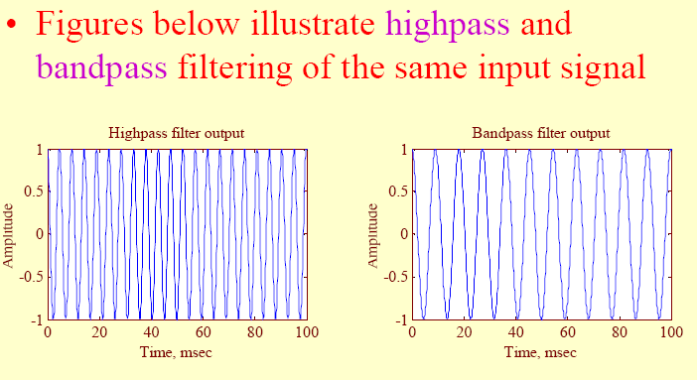

Slide 46
Filtering
There are various other types of filters
A filter blocking a single(单个的) frequency component is called a notch filter(陷波器)
A multiband(多频带) filter has more than one passband and more than one stopband
A comb filter(梳状滤波器) blocks frequencies that are integral multiples(整数倍) of a low frequency

Slide 47

Filtering
In many applications the desired signal occupies a low-frequency band from dc to some frequency f_{L}Hz, and gets corrupted
by a high-frequency noise with frequency components above f_{H} Hz with f_{H} >f_{L}
In such cases, the desired signal can be recovered from the noise-corrupted signal by passing the latter through a lowpass filter with a cutoff frequency

Slide 48
Filtering
Example
common source of noise is power lines(电力线) radiating(辐射) electric and magnetic fields(电磁场)
The noise generated by power lines appears as a 60Hz sinusoidal signal corrupting the desired signal and can be removed by passing the corrupted signal through a notch filter with a notch frequency at 60 Hz

Slide 49
Multiplexing and Demultiplexing
For an efficient utilization of a wideband transmission channel, many narrow-bandwidth low-frequency signals are combined for a composite wideband signal that is transmitted as a single signal
The process of combining the low- frequency signals is called multiplexing(复用)

Slide 50
Multiplexing and Demultiplexing
Multiplexing is implemented to ensure that a replica of each of the original narrow-bandwidth low-frequency signal can be recovered at the receiving end
The recovery process of the low-frequency signals is called demultiplexing(解复用)

Slide 51
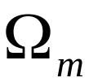
Multiplexing and Demultiplexing
One method of combining different voice signals in a telephone communication system is the frequency-division multiplexing (FDM) scheme
Here, each voice signal, typically bandlimited to a low-frequency band of width , is frequency-translated into a higher frequency band using the amplitude modulation method

Slide 52

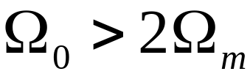
Multiplexing and Demultiplexing
The carrier frequency of adjacent amplitude-modulated signals is separated by , where to ensure that there is no overlap in the spectra of the individual modulated signals after they are added to form the baseband composite signal
The composite signal is then modulated onto the main carried developing the FDM signal and transmitted

Slide 53
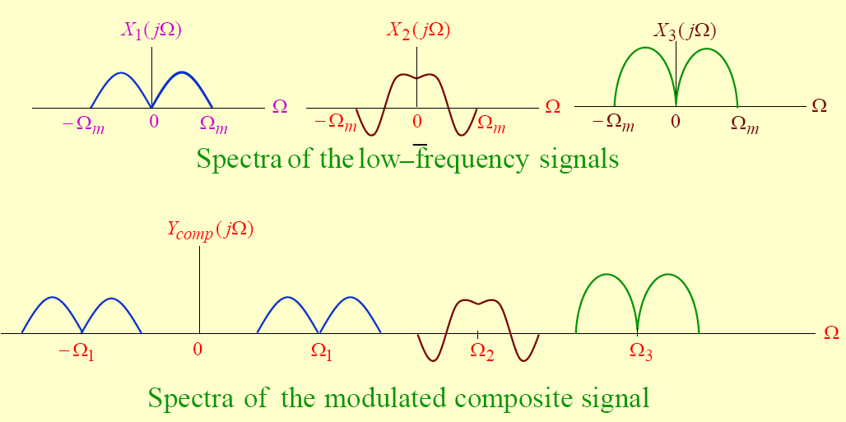

Slide 54
Multiplexing and Demultiplexing
At the receiving end, the composite baseband signal is first recovered from the FDM signal by demodulation
Then each individual frequency-translated signal is demultiplexed by passing the composite signal through a bank of bandpass filters

Slide 55
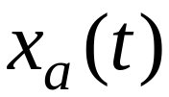




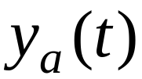




Digital Processing of Analog Signals
LPF_{in}
ADC
DSP
DAC
LPF_{out}
LPF_{in}is the Prefilter or Antialiasing Filter: it conditions the analog signal to prevent aliasing (Sampling Theorem: )
ADC is the Analog-to-Digital Converter: it consists of an ideal sampler followed by a quantizer and produces a stream of binary digits encoding the samples of taken at a rate , T being the sampling period

Slide 56
Digital Processing of Analog Signals
LPF_{in}
ADC
DSP
DAC
LPF_{out}
DSP is the Digital Signal Processor: it’s the heart of the DSP system and can represent a computer, special-purpose HW, a SW algorithm, etc.
DAC is the Digital-to-Analog Converter: it consits of an interpolator and produces a staircase waveform from the sequence of binary digits representing , the processed version of
LPF_{out} is the Postfilter: it performs the smoothing of into

Slide 57
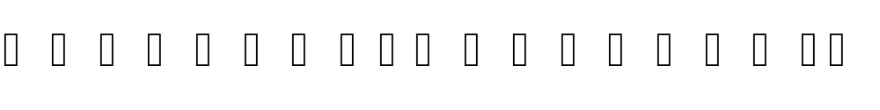
Digital Processing of Analog Signals
LPF_{in}
ADC
DSP
DAC
LPF_{out}
Equivalent Analog Signal Processor
ASP

